Slide 1

Confusion Matrix Metrics Part 8 (ROC Curve and AUC)
Machine Learning

Slide 2
ROC Curve
Very simply put, an ROC curve is a collection of points of two metrics (TPR and FPR) derived off confusion matrices at different thresholds for a given classifier.
Now let us understand what the above sentence really means!
And just to calm your nerves… it is NO rocket science!

Slide 3
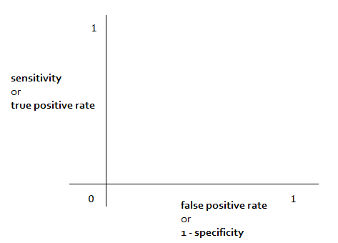
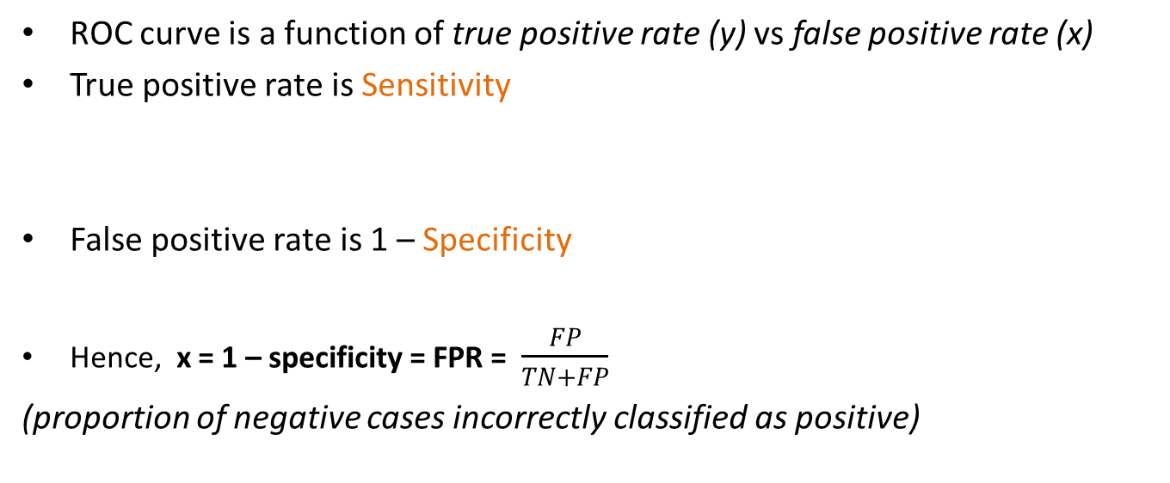


ROC curve is a function of true positive rate (y) vs false positive rate (x)
True positive rate is Sensitivity
False positive rate is 1 – Specificity
Hence, x = 1 – specificity = FPR = $\frac{FP}{TN+FP}$
(proportion of negative cases incorrectly classified as positive)
y = Sensitivity = TPR = $\frac{TP}{TP+FN}$
specificity= $\frac{TN}{TN+FP}$

Slide 4

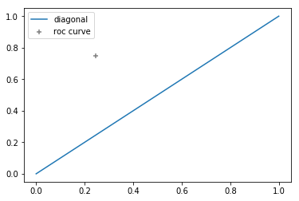


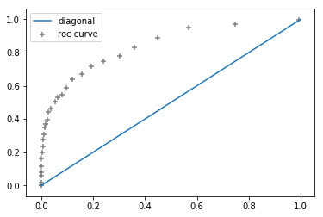


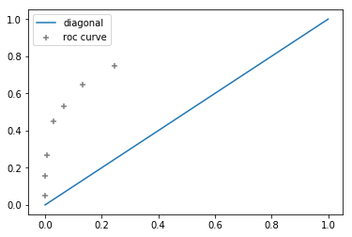




Let us build our ROC Curve
y axis : 305/(305+102) = 0.75 (TPR)
X axis : 393/(393+1200) = 0.25 (FPR)
Sensitivity = TPR = $\frac{TP}{TP+FN}$
1 – Specificity = FPR = $\frac{FP}{TN+FP}$
For threshold = 0.2
For 30 equally spaced thresholds between 0 and 1
For all of the given thresholds

Slide 5
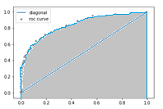
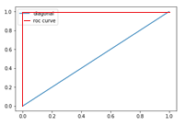
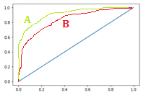
Area under the ROC Curve
AUC is the area under the ROC curve
AUC for a perfect classifier = 1.0 It makes no mistakes whatsoever at any threshold.
Worst classifier: x = y, or AUC = 0.50 the line of “no discrimination” (the blue diagonal) (baseline classifier)
For our data
For a perfect classifier
[ 0 0 0 1 1 1 ] true classes
[0.01, 0.01, 0.01, 0.99, 0.99, 0.99] probabilities
Sensitivity = TPR = $\frac{TP}{TP+FN}$
Classifier A > Classifier B
1 – Specificity = FPR = $\frac{FP}{TN+FP}$

Slide 6
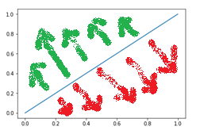
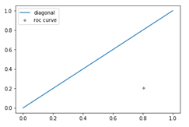
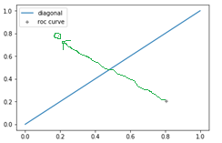
What does it mean to have, say, a ROC AUC score of 0.82?
It means that there is an 82% probability that a randomly selected positive sample will be assigned a higher probability than a randomly selected negative sample
So AUC = 1 implies every positive sample is assigned a better probability of being in the positive class than every negative sample – IDEAL SCENARIO!

Slide 7
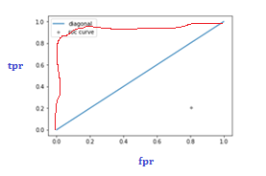

LIMITATIONS
ROC curves should NOT be used when the number of negative samples outnumber the positive samples by a huuuuge amount (severe class imbalance)
Should NOT be used when we’re only concerned about prediction of one class.
WHY?
In a hugely imbalanced dataset, if we have a very high number of true negatives, then our x axis in ROC curve (FPR) which has TN in denominator, will be a very small number, which will push our ROC plot to the left side, and shoot up our ROC AUC value to be close to 1, which is misleading.
PR Curves are better in these cases
1 – Specificity = FPR = $\frac{FP}{TN+FP}$

Slide 8
That would be all for this one
Thank you for watching :)

Slide 9
Confusion Matrix Metrics Part 9 (Precision Recall Curve and AUC)
Machine Learning

Slide 10
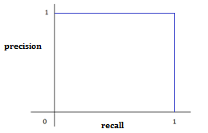
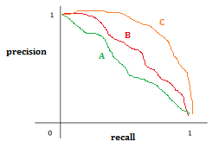


PR Curve
PR curve is a function of precision (y) and recall (x)
x = Recall = $\frac{TP}{TP+FN}$
y = Precision = $\frac{TP}{TP+FP}$
x axis : 305/(305+102) = 0.75 (recall)
y axis : 305/(305+393) = 0.44 (precision)
Perfect classifier, having P=1 and R=1
AUC = 1 (max)
Three different classifiers.
C > B > A because C has highest AUC
[ 0 0 0 1 1 1 ] true classes
[0.01, 0.01, 0.01, 0.99, 0.99, 0.99] probabilities
Baseline PR Curve AUC is given by total positive samples/total data samples
So if we have 100 data samples, and only 20 belong to the “positive” class, then baseline AUC = 20/100 = 0.20

Slide 11
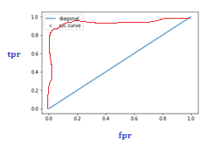

ROC Curve vs PR Curve
In a hugely imbalanced dataset, if we have a very high number of true negatives, then our x axis in ROC curve (FPR) which has TN in denominator, will be a very small number, which will push our ROC plot to the left side, and shoot up our ROC AUC value to be close to 1, which is misleading.
1 – Specificity = FPR = $\frac{FP}{TN+FP}$

Slide 12


ROC Curve vs PR Curve
PR Curves have precision and recall values, which do not make use of the True Negatives at all!
Hence they become suitable for such analyses where the number of TN is very much huge, or when the existence of True Negatives doesn’t play a major role in the business problem (eg. information retrieval)
x = Recall = $\frac{TP}{TP+FN}$
y = Precision = $\frac{TP}{TP+FP}$

Slide 13
That would be all for this one
Thank you for watching :)

